Slide 1

MOBILE 2
features
EVENTME APPLICATION PROJECT
teams
about
limitation
NGUYEN MINH TOAN – 300282395
TRUONG THANH THAO - 300284134

Slide 2

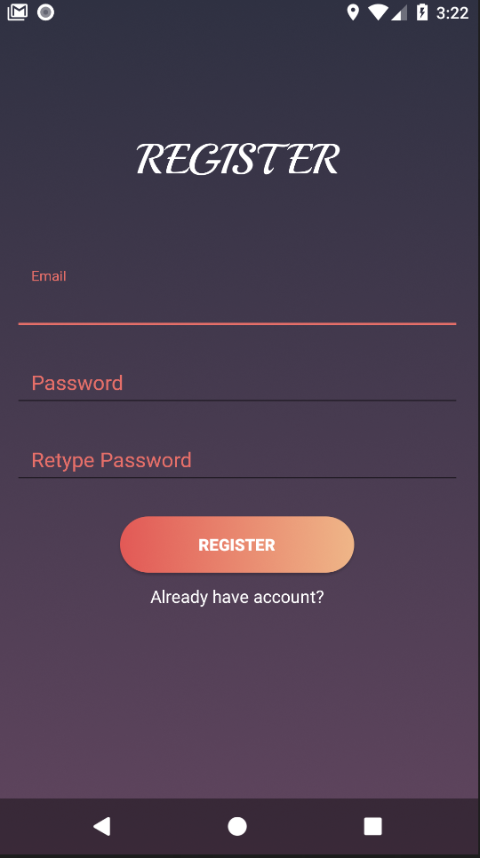
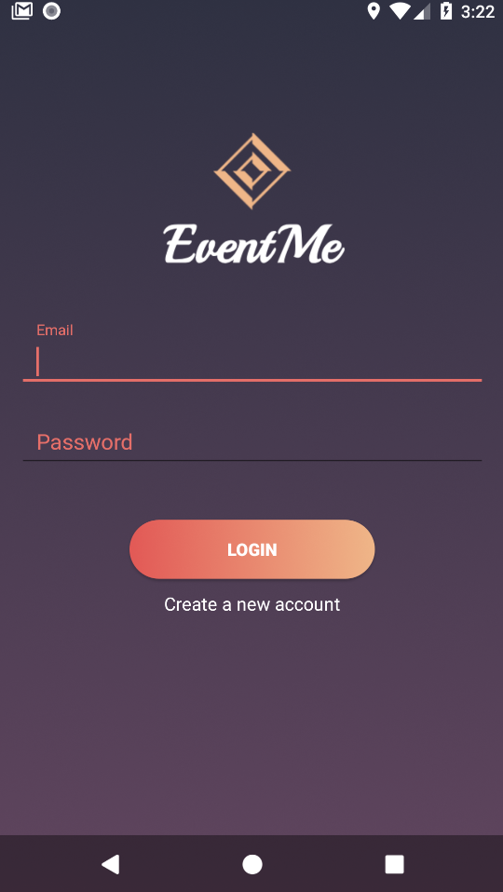
EventMe
Multi-users app
Real-time experience
Locate user’s current location and recommend nearby events
Enables users create and manage their own events
teams
features
about
limitation

Slide 3
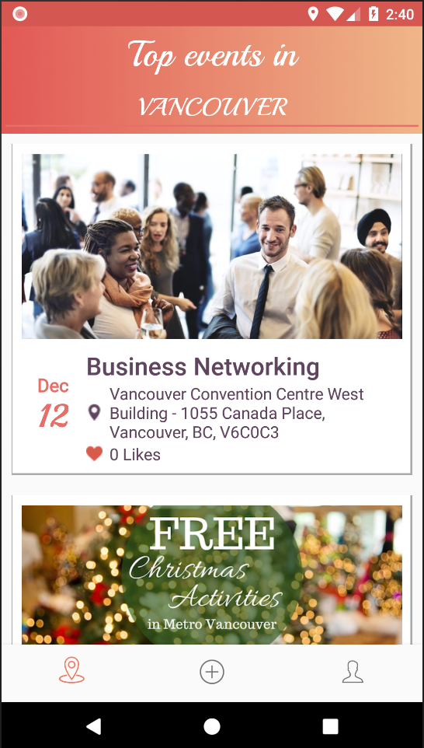
Techniques
Search events by location
(default: device’s location)
Firebase
Google Map API
Dynamic Fragments
Lists View
Picasso Library
Coordinator Layout
Loading Bar
Floating Action Button
Bottom Navigation
teams
General information of the events
features
limitation
about

Slide 4
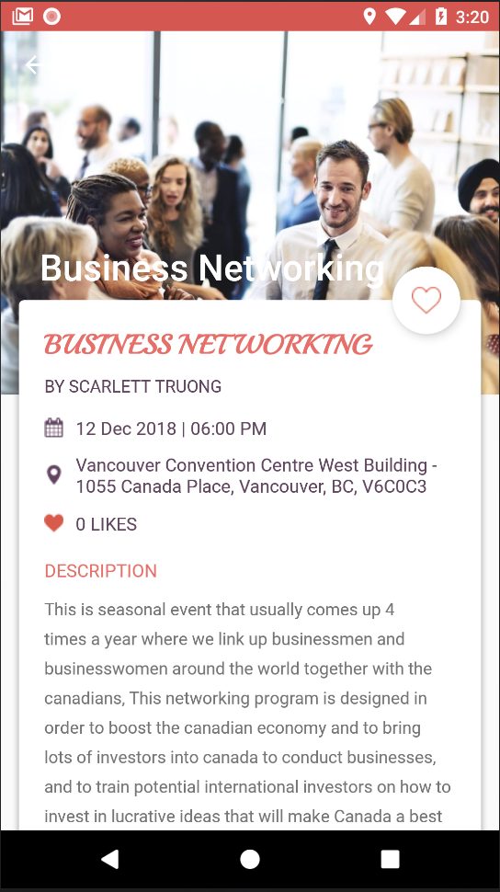
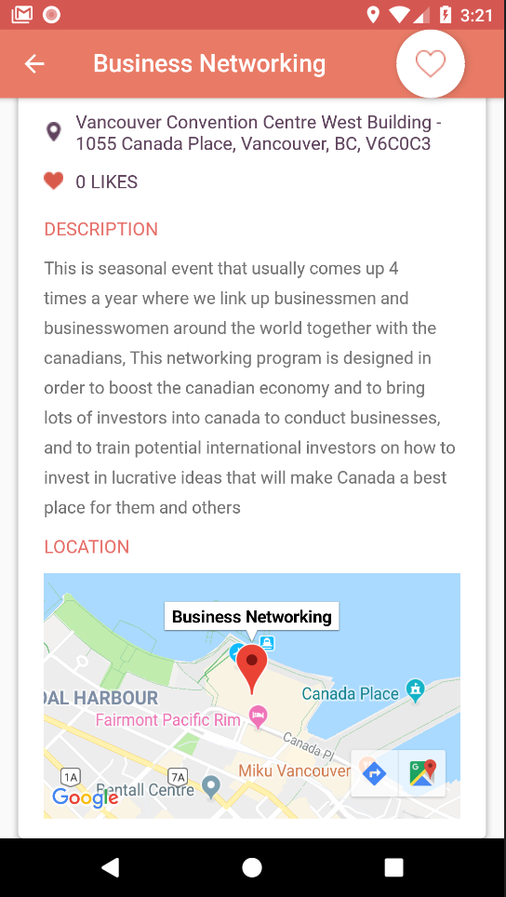
User can like an event
Details information of an event:
Event name
Creator
Date & Time
Location
Number of people liked
Description
teams
features
limitation
about
View with Google Map

Slide 5
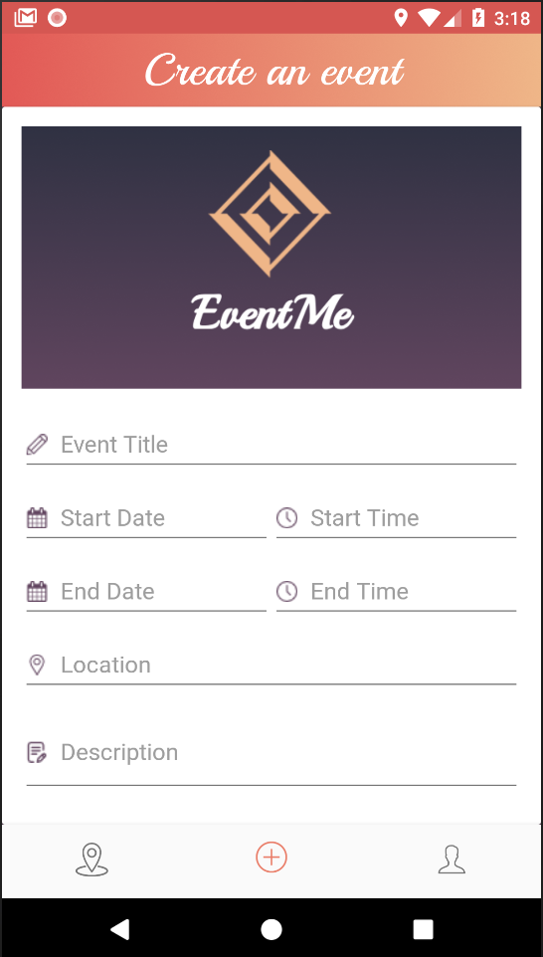
Techniques
Upload your own event’s image
Firebase
Dynamic Fragments
Picasso Library
Cái date/time a có dung j đặc biệt ko?
teams
features
limitation
about
Input your event’s information

Slide 6
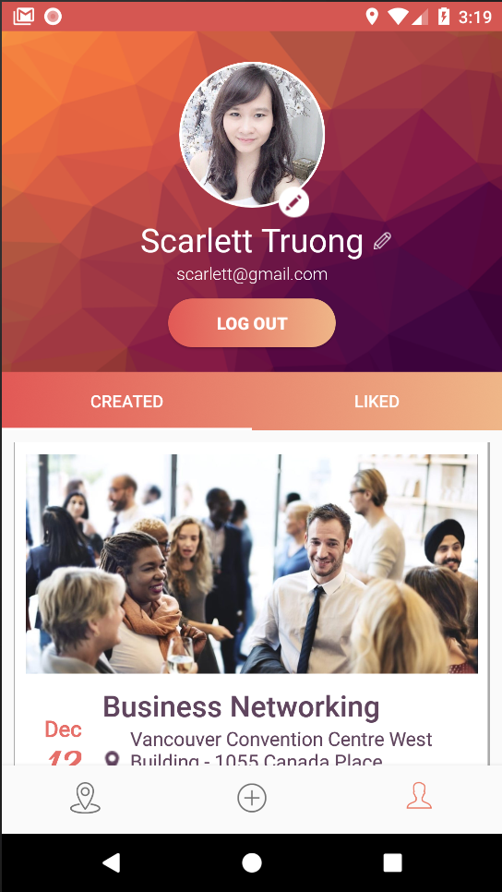
Techniques
Upload your own profile’s image
Edit your name
Nested Fragments
Tab Layout
Lists View
Picasso Library
View all your created events
teams
features
limitation
about
View all your liked events

Slide 7

Users cannot edit or delete created events
Events are not categorized
Users cannot view/follow other users
Cannot search event’s name / date range
features
teams
limitation
about
User profile toolbar is not scrollable
Liked tab in user’s profile is not refresh immediately

Slide 8
THANK YOU FOR LISTENING !!!
teams
features
limitation
about
TOAN NGUYEN
THAO TRUONG
(Scarlett)
300282895
300284134

